Slide 1
Natural Language Processing Toolkit Notes
17/02/2017

Slide 2
How NLTK get nouns/ verbs
Steps:
Tokenize text
Tag words
Chunk sentences
Tags for nouns and verbs:
NN noun, singular 'desk'
NNS noun plural 'desks'
NNP proper noun, singular 'Harrison'
NNPS proper noun, plural 'Americans‘
VB verb, base form take
VBD verb, past tense took
VBG verb, gerund/present participle taking
VBN verb, past participle taken
VBP verb, sing. present, non-3d take
VBZ verb, 3rd person sing. present takes

Slide 3
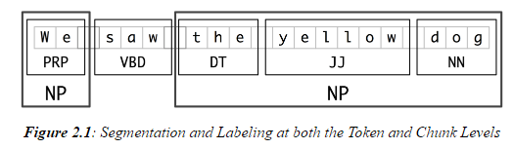
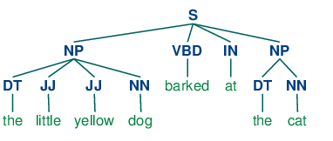
Chunk structure for a given sentence
by regular expression
<RB.?>*<VB.?>*<NNP>+<NN>?
<RB.?>* = "0 or more of any tense of adverb," followed by:
<VB.?>* = "0 or more of any tense of verb," followed by:
<NNP>+ = "One or more proper nouns," followed by:
<NN>? = "zero or one singular noun. "
<DT>?<JJ>*<NN>
<DT>? = "optional determiner,“ followed by:
<JJ>* = "0 or more of any tense of adjective," followed by:
<NN>= " one singular noun.“

Slide 4
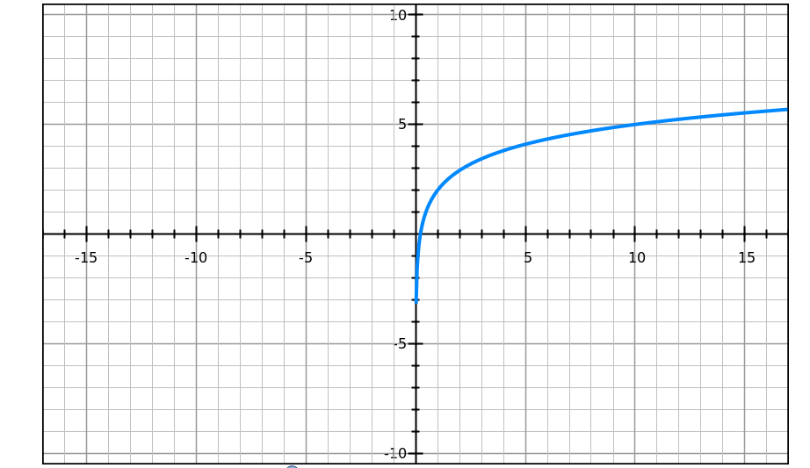
Filter by frequency
Filter out infrequently nouns
Counts how many times a word shows up in text
Use threshold to cut infrequently words
A guess about show up frequency of a character in text
Frequency might be a function of story length, frequency = f( story length)
f( story length) might be in logarithmic form
Story is longer, a character might show up more times
But, also when story is long enough, new characters will probably show up

Slide 5
Sample corpus
The family of Dashwood had long been settled in Sussex.
Their estate was large, and their residence was at Norland Park, in the centre of their property, where, for many generations, they had lived in so respectable a manner as to engage the general good opinion of their surrounding acquaintance.
The late owner of this estate was a single man, who lived to a very advanced age, and who for many years of his life, had a constant companion and housekeeper in his sister.
But her death, which happened ten years before his own, produced a great lteration in his home; for to supply her loss, he invited and received into his house the family of his nephew Mr. Henry Dashwood, the legal inheritor of the Norland estate, and the person to whom he intended to bequeath it.

Slide 6
Two way to combine verbs
Get verbs between two nouns
Get verbs in same sentence

Slide 7
Current Progress
Current:
Get all nouns from text
Filter infrequent nouns
Combine nouns and verbs, <Noun, Verb> (Only simple version)
Next:
Deal with pronoun
Find more chunking ways

